Slide 1
Principal Component Analysis (PCA)
Learn How to Manage Data Dimensionality Without Losing Information

Slide 2
Contents
01
02
Need for Data Reduction
Relevance of Variation and Correlation
03
04
Principal Component Analysis
PCA-Choice of Analysis Matrix
05
06
PCA- Number of Components
Case Study-Athletics Records

Slide 3
The Need For Data Reduction
Explosion in information collection techniques and data availability has resulted in data scientists facing a unique requirement – Need for reducing data.
But how can more information be a problem?
Does this mean simply removing data? Definitely not.
Key rule is - Lose data but not information!
Not all data fields are useful.
Variables can be highly correlated or at times redundant
Most data analysis algorithms work on columns (variables).
Large number of variables may result in slowing down of the process.

Slide 4
What Is High Dimensional Data?
Definition:
Majority of the real world analytics - in the fields of medical sciences, ecology, biology, finance, etc. - deals with datasets having a few dozens to hundreds and at times thousands of variables. Also the number of cases can go up several million depending upon the industry.
Example:
Consider a dataset with patient medical records containing hundreds of measurements including vital signs, lab results, genetic markers, imaging data, and treatment histories. Each patient represents one observation, but the number of variables can easily exceed 1,000, creating a high-dimensional dataset that requires dimensionality reduction techniques.

Slide 5
Data Reduction
Summary of data with p variables by a smaller set of (k) derived variables.
These k derived variables are linear combinations of original p variables.
In short, n * p matrix is reduced to n * k matrix.
 | X₁ | X₂ | . | . | . | . | . | . | X_{p}
1
2
.
.
.
n
 | Y₁ | Y₂ | . | . | Y_{k}
1
2
.
.
.
n
Linear Combinations

Slide 6
Variation and Correlation - Key Data Features
Variation in the data is nothing but the information that the data gives.
Variables in the data can be highly correlated.
Example: Employee satisfaction survey asks the following questions:
Do you think you are rewarded regularly for your work?
Do you think the system monitoring your performance is flawed?
Do you get timely encouragement from your supervisors regarding your work?
The above three questions measure the robustness of employee work review. Having three questions to represent a common area can be considered redundant.
Reduction is justified when there is such Correlation present in the data.

Slide 7
Principal Component Analysis (PCA)
PCA is probably the most widely-used and well-known of the "Standard" multivariate methods.
The method was invented by Pearson (1901) and Hotelling (1933).
The method was first applied in ecology by Goodall (1954) under the name "Factor Analysis". ("Principal Factor Analysis" is a synonym of PCA).

Slide 8
Principal Component Analysis (PCA)
1. PCA uses correlation structure of original p variables and derives p linear combinations which are uncorrelated.
2. Each Principal Component provides unique information about the data.
3. Although 'p' principal components are derived, first 'k' principal components are expected to explain most of the variability in the data.

Slide 9
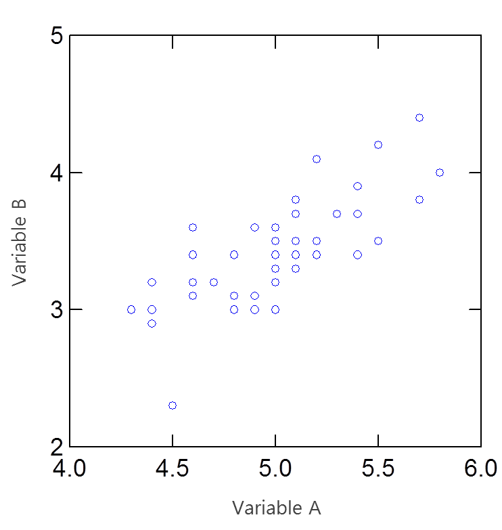
PCA-General Concept
Consider 2 variables A & B (Assume that A & B are features of an object)
A & B have approximately same variance and are highly correlated
Fig. 01
Now suppose we pass a vector through the scatter points such that it is a good linear fit to the data points. This could be considered a new feature of the object which is a linear combination of A & B.
We then plot a second line which is perpendicular to the vector, such that both lines pass through the centroid of the data. This becomes our second linear combination.
2nd Principal
Component, y₂
1st Principal
Component, y₁

Slide 10
PCA-General Concept
From p original variables: x₁,x₂,..., x_{p,} derive p new variables y₁,y₂,..., y_{p}
Although p principal components are derived, data reduction is achieved with first k principal components.
Properties of Principal Components :
y_{k}'s are uncorrelated (Orthogonal).
y₁ explains as much as possible of original variance in data set.
y₂ explains as much as possible of remaining variance. And so on.
y₁ = a₁₁x₁ + a₁₂x₂ + ... + a_{1p}x_{p}
y₂ = a₂₁x₁ + a₂₂x₂ + ... + a_{2p}x_{p}
.
.
.
y_{p} = a_{p1}x₁ + a_{p2}x₂ + ... + a_{pp}x_{p}
y_{k}'s are
Principal Components

Slide 11
PCA – Choice of Matrix Analysis
Which Matrix Should be Used?
Variance-Covariance Matrix
If variables are measured on same units. Even then variables with high variances will dominate principal components.
Correlation Matrix
It is equivalent to using standardized variables.
Better choice for PCA than variance-covariance matrix
* Correlation matrix of original variables = Variance-covariance matrix of standardized variables.

Slide 12
Principal Components – Definition
First Component
A linear combination a₁₁x₁ + a₁₂x₂ + ... + a₁ₚxₚ which has maximum variance among all possible linear combinations, subject to a₁₁² + a₁₂² + ... + a₁ₚ² = 1. ( First Principal Component is the eigen vector corresponding to the largest eigen value of the correlation matrix)
Second Component
A linear combination a₂₁x₁ + a₂₂x₂ + ... + a₂ₚxₚ which has maximum variance among all remaining linear combinations, subject to a₂₁² + a₂₂² + ... + a₂ₚ² = 1 and zero correlation with first principal component. (Second Principal Component is the eigen vector corresponding to the second largest eigen value of the correlation matrix)
Third Component
Similarly third Principal Component is obtained which will be uncorrelated with first and second principal components.
And so on..

Slide 13
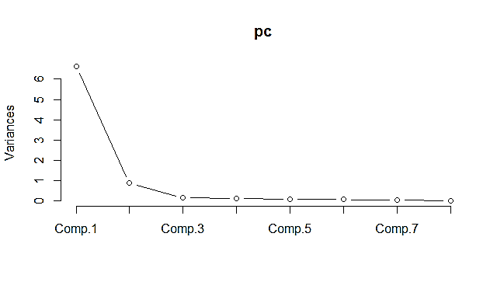
How Many Principal Components to Retain
P principal components are derived but data reduction is achieved with first k PC’s.
Retain principal components associated with Eigen Value more than ‘1’.
Variance of PCs is equal to associated Eigen Value. This is known as “Kaiser Criterion”.
Look at a Scree plot and check for “Elbow" to determine the correct number of PCs to use.
A scree plot shows how much variation each PC captures from the data. The y axis is eigenvalues, which essentially stand for the variation.
Example of Scree Plot below shows that, first principal component is sufficient to explain variation in the data.

Slide 14
Case Study – Athletics Records
Background
Data on national athletics records for various countries is available.
Objective
To achieve data reduction and obtain score for each country which can be used to rank countries based on athletics records.
Available Information
Data Source: Applied Multivariate Statistical Analysis by Richard A. Johnson, Dean W. Wichern
Sample size is 55 countries athletics.
Records for 8 different athletics events – 100 meters to Marathon

Slide 15
Athletics Data Snapshot
Country | 100m_s | 200m_s | 400m_s | 800m_min | 1500m_min | 5000m_min | 10000m_min | Marathon_min
Argentina | 10.39 | 20.81 | 46.84 | 1.81 | 3.7 | 14.04 | 29.36 | 137.72
Australia | 10.31 | 20.06 | 44.84 | 1.74 | 3.57 | 13.28 | 27.66 | 128.3
Austria | 10.44 | 20.81 | 46.82 | 1.79 | 3.6 | 13.26 | 27.72 | 135.9
Belgium | 10.34 | 20.68 | 45.04 | 1.73 | 3.6 | 13.22 | 27.45 | 129.95
Bermuda | 10.28 | 20.58 | 45.91 | 1.8 | 3.75 | 14.68 | 30.55 | 146.62
Brazil | 10.22 | 20.43 | 45.21 | 1.73 | 3.66 | 13.62 | 28.62 | 133.13
Burma | 10.64 | 21.52 | 48.3 | 1.8 | 3.85 | 14.45 | 30.28 | 139.95
Canada | 10.17 | 20.22 | 45.68 | 1.76 | 3.63 | 13.55 | 28.09 | 130.15
Chile | 10.34 | 20.8 | 46.2 | 1.79 | 3.71 | 13.61 | 29.3 | 134.03
China | 10.51 | 21.04 | 47.3 | 1.81 | 3.73 | 13.9 | 29.13 | 133.53
Colombia | 10.43 | 21.05 | 46.1 | 1.82 | 3.74 | 13.49 | 27.88 | 131.35

Slide 16
Athletics Data – Variable Description
Column | Description | Type | Measurement | Possible Values
Country | Country Name | Categorical | - | -
100m_s | Time for 100 meter running | Continuous | Seconds | Positive Values
200m_s | Time for 200 meter running | Continuous | Seconds | Positive Values
400m_s | Time for 400 meter running | Continuous | Seconds | Positive Values
800m_min | Time for 800 meter running | Continuous | Minutes | Positive Values
1500m_min | Time for 1500 meter running | Continuous | Minutes | Positive Values
5000m_min | Time for 5000 meter running | Continuous | Minutes | Positive Values
10000m_min | Time for 10000 meter running | Continuous | Minutes | Positive Values
Marathon_min | Time for Marathon running | Continuous | Minutes | Positive Values

Slide 17
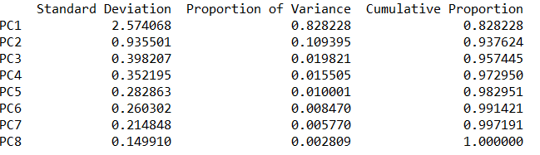
PCA :Variance Explained ( Based on Correlation Matrix)
# Output:
Interpretation:
summary gives std. deviation (sd), proportion of variance and cumulative proportion. Variance is nothing but the Eigenvalue of correlation matrix.
First Principal Component explains 83% of the variation. Note that 8 PC’s are derived using 8 variables but first PC explains most of the variation.

Slide 18
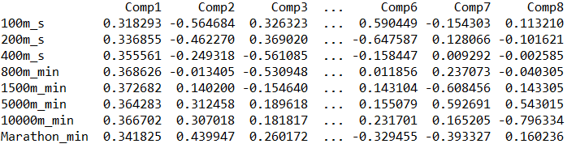
PCA: Loadings Matrix
#Component Loadings
Interpretation:
First Principal Component can be interpreted as ‘general athletics skill’ since all variables have similar loadings.
The loadings represent the coefficients (weights) for each original variable in the linear combination that forms the principal component. When all loadings are similar in magnitude, it indicates that the principal component is a balanced combination of all original variables.
In this athletics case, all eight running events contribute roughly equally to the first principal component, suggesting it captures overall athletic performance rather than specialization in any particular event.

Slide 19
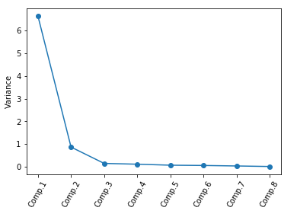
Scree Plot Analysis
Scree Plot: plot the principal components vs. variances
Interpretation:
First Principal Component is sufficient in explaining the maximum variation.
The scree plot visually displays the eigenvalues (variances) associated with each principal component. The plot typically shows a steep decline followed by a leveling off, creating an "elbow" shape.
In this athletics dataset, the first principal component has a dramatically higher eigenvalue than the remaining components, indicating it captures the vast majority of variance. The subsequent components add relatively little additional information, confirming that dimensionality reduction from 8 variables to 1 principal component is highly effective.

Slide 20
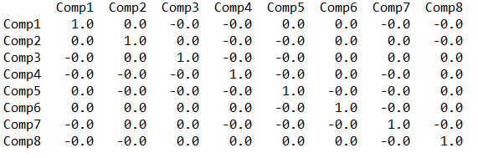
The principal components are uncorrelated
One of the fundamental properties of PCA is that the derived principal components are mathematically guaranteed to be uncorrelated (orthogonal) with each other. This can be verified by computing the correlation matrix of the principal component scores.
The correlation matrix should show values of 1.0 on the diagonal (each component perfectly correlated with itself) and values of 0.0 (or very close to 0.0 due to rounding) for all off-diagonal elements, confirming zero correlation between different principal components.
This orthogonality property ensures that each principal component captures unique, non-redundant information from the original dataset, making PCA an effective technique for data reduction and feature extraction.

Slide 21
How PCA is Used in Further Analysis
Principal Component Analysis serves as a powerful preprocessing technique that enhances the performance and interpretability of downstream analytical methods. By reducing dimensionality while preserving information, PCA creates a transformed feature space that benefits multiple analytical approaches.
Clustering Analysis
PCA improves clustering algorithms by reducing noise and computational complexity. K-means, hierarchical clustering, and DBSCAN perform more effectively in the reduced PC space, with clearer cluster separation and faster convergence. The principal components help identify natural groupings that might be obscured in high-dimensional space.
Regression Modeling
Principal Component Regression (PCR) addresses multicollinearity issues by using uncorrelated PCs as predictors instead of original variables. This stabilizes coefficient estimates, reduces overfitting, and improves model generalization. PCR is particularly valuable when predictor variables are highly correlated.
Scoring and Ranking
PCA enables creation of composite scores for complex constructs. The first principal component often serves as a weighted index combining multiple variables. This is widely used for creating performance scores, risk indices, quality metrics, and ranking systems across industries from finance to healthcare.

Slide 22
Key Takeaways
PCA Solves the Dimensionality Problem
When faced with datasets containing dozens or hundreds of correlated variables, PCA provides an elegant solution by transforming them into a smaller set of uncorrelated principal components that capture most of the original information. This addresses computational efficiency, multicollinearity, and visualization challenges.
Information Preservation is Paramount
The fundamental principle of PCA is to reduce data without losing information. The first few principal components typically explain 80-90% of total variance, allowing dramatic dimensionality reduction while maintaining the essence of the original dataset. Always validate that retained components explain sufficient variance.
Standardization Matters
Using the correlation matrix (equivalent to analyzing standardized variables) is generally preferred over the covariance matrix. This ensures variables with larger scales don't dominate the principal components. Standardization puts all variables on equal footing regardless of their original measurement units.

